Slide 1

Prudential
Clifford Grimm
April 23, 2013
PROVIDING GUIDANCE Remove notes as you build your presentation.
NOTE

Slide 2


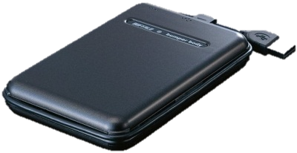


Option 1
HCP-DM via REST
Tool Log DB
Web Access
Search for Calls
Virtual or Physical Machine
Scan files (NFS)
Add Custom Metadata
(REST)
Tool Log File
COMET Tool
Web Access
Perform Audit
Search and Remove Driver Files

Slide 3
Option 1
Data copied directly TO HCP
All the NICE data is copied directly onto HCP
Tool Options:
Use HCP-DM (Preferred)
Use standard OS copy commands
Use COMET tool to add custom metadata to NICE call data
Only file information or “driver” files are accessed
(Optional) Search for all Driver files on HCP and remove using HCP Search Console as these files are regenerated in Custom Metadata
Use HCP Search Console (or Application) to locate call data based on criteria

Slide 4
Option 1 (Cont)
Pros
Does not require 2x storage to save content (stage and final)
Most efficient potential for bulk data move
COMET tool data touch is very minimal thus reduced network traffic and better objects/hour processing to add Custom Metadata
Cons
Assumes current file structure is acceptable

Slide 5
Option 2
Copy Files
Walk FS
and Read
Web Access
Search for Calls
Virtual or Physical Machine
Object and CM
Tool Log File
COMET Tool
Web Access
Perform Audit

Slide 6
Option 2
Data staged to local storage
All NICE data is staged to temporary storage
COMET tool is used to both ingest and add custom metadata
Tool can avoid writing unnecessary “Driver” files

Slide 7
Option 2
Pros
Avoids Driver data from being written HCP and then later removed.
Cons
Requires 6TB of temporary storage
Bulk data migration into HCP is less efficient via tool
Will require 2x data transfer
Once to temp storage and then to HCP

Slide 8
Thank you

